Slide 1
REMAINING USEFUL LIFE PREDICTION OF BEARING USING SELF ORGANIZING MAP AND SUPPORT VECTOR REGRESSION
SANKET DOFE (181080022) RISHIKESH HIRDE (181080032) SIDDHESH BAHURUPI (181080067) MRUNAL BELE (181080013)

Slide 2
PROBLEM STATEMENT
Bearings are critical components of rotating machines since the failure of these may cease the functioning of the entire equipment. The damages observed due to bearing failures are huge and thus there is a need to develop an effective prognostic methodology to prevent the sudden machinery breakdown.
Accurate determination of remaining useful life of bearing is an important issue and a methodology needs to be created to address this issue that accurately predicts the Remaining Useful Life of the bearing so that when it passes a certain level, the corresponding bearings can be replaced so as to avoid failure of equipment.

Slide 3
DATASET
Dataset used for this project is ‘IEEE PHM 2012 Dataset’ which contains the datasets for bearings experimented under 3 conditions
Datasets containing the observations for the bearings until failure occurs : Training set
Datasets containing the observations for the bearings which are truncated before the failure occurs and for these datasets, the remaining useful life is given which is needed to be predicted : Test Set.

Slide 4
DATASET Description
For a particular condition, some bearings were experimented separately. For a particular bearing, set of observations were taken out every 10 seconds. Every 10 seconds, 2560 observations of vibrations were taken out and these were exported in a csv file.
For bearings experimented until failure contains all the csv files generated every 10 seconds until failure which has been used as training set.
For bearings experimented and the observations truncated which can be used as the test set contains the csv files generated every 10 seconds before the data has been truncated.

Slide 5
DATASET Description
Each csv file contains the following attributes:
Hour: Hour at which these observations were carried out
Minute: Minute at which these observations were carried out
Second: Second at which these observations were carried out
Microseconds: microsecond at which the particular observation was taken
Horizontal Acceleration: Vibrational signal along horizontal axis observed
Vertical Acceleration: Vibrational signal along horizontal axis observed

Slide 6
Motivation
The accurate determination of remaining useful life is a key issue in prognostics of rolling element bearings.
In our project we are estimating the remaining useful life of bearings based on self-organizing map and support vector regression.
The use of Self Organizing Map was itself a new concept that made us to go with project. The feature extraction especially the frequency domain features from the raw signals was a thing we noticed was different from others and thus we thought of going with this project.
The motivation for doing this project was primarily an interest in undertaking a challenging project in an interesting area of research. The opportunity to learn about a new area of machine learning apart from theoretical knowledge was appealing.

Slide 7

Terminology: Self Organizing Map
SOM is an adaptive unsupervised neural network used to classify the data by projecting the high-dimensional feature vectors onto two-dimensional topology maps.
The training of the SOM takes place in the following steps:
Initially, the weight vector of each neuron is loaded arbitrarily
The input vector selected randomly is supplied to all the neurons at a time.
The neuron most similar to the presented input vector is determined. The winning neuron is called as the best matching unit (BMU).
The weight vector of BMU and its adjacent neurons are updated using the Kohonen’s learning rule.
The steps ii to iv are repeated for all the input data.

Slide 8
Terminology: Support Vector Regression
Given a set of training data X = [(xi,di), i=1,. . ...,N], where xi is the input feature vector, di is the corresponding target vector, the regression function to be estimated is defined as y = w.φ(x) + b
where φ(x) represents the feature of inputs, w is the weight vector and b is a constant. w and b are obtained by minimizing the constrained regularized cost.
Support Vectors: Support Vectors are those points in the space that are closer to the hyperplane and also decide the orientation of the hyperplane. The lines or planes drawn is called Support Vector Lines or Support Vector Planes.
Hyperplane: In Support Vector Regression, this is the line that will be used to predict the continuous output.
Kernel: A kernel Function is used to map the lower dimensional features to a higher dimension so as to find an optimal hyperplane for the input data.
SVR gives us the flexibility to define how much error is acceptable in our model and will find an appropriate line (or hyperplane in higher dimensions) to fit the data.

Slide 9
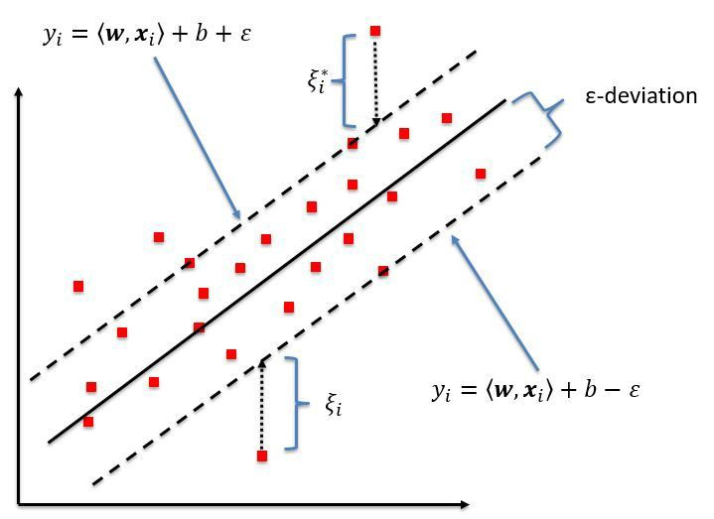
Terminology: Support Vector Regression
The objective function of SVR is to minimize the coefficients, not the squared error. The error term is instead handled in the constraints, where we set the absolute error less than or equal to a specified margin, called the maximum error, ϵ.
The value of epsilon determines the width of the tube around the estimated hyperplane. Points that fall inside this tube are considered as correct predictions and are not penalized by the algorithm.
ξ measures the distance to points outside the tube, and can control how much to care about it by tuning a regularization parameter C.

Slide 10
Methodology
This project is based on the research paper ‘Intelligent bearing performance degradation assessment and remaining useful life prediction based on self-organising map and support vector regression’ by Akhand Rai and Sanjay H Upadhyay.
The paper has made use of the Self Organizing Map and Support Vector Regression for the learning and prediction of Remaining Useful Life of the bearings.

Slide 11
Methodology: Steps Followed
Feature Extraction
Self Organizing Map (SOM)
Minimum Quantization Error(MQE)
Life Percentage
BHI (Bearing Health Index)
Support Vector Regression (SVR)
Predicting RUL

Slide 12
Methodology: Steps followed
Feature Extraction:
Input dataset is a time series data of vibrational signals.
Number of time-domain features and frequency domain features have been identified that are extracted from the datasets.
The horizontal acceleration attribute in csv file is used for feature calculation. Each csv file corresponding to observations taken every 10 seconds is converted to a feature vector.
Time domain features:
RMS
Kurtosis
Skewness
Crest Factor
Impulse Factor
Shape Factor
Margin Factor
Peak to Peak
Frequency domain features:
Mean Frequency
Frequency Centre
Root Mean Square Frequency
Spectral Entropy of raw signal
Spectral Entropy of envelope signal

Slide 13
Methodology: Steps followed
2. Self Organizing Map
A set of healthy features that corresponds to the features that represents the bearing is in a healthy state i.e. it is not damaged is taken from the features extracted in the previous step and are the first 1/5th feature vectors as these will always be the features corresponding to the bearing in a healthy state.
These healthy features are used to train the Self Organizing Map.

Slide 14
Methodology: Steps followed
3. Minimum Quantization Error(MQE)
The Minimum Quantization Error corresponds to the Euclidian distance between the input features and its corresponding BMU.
The remaining feature vectors (apart from healthy feature vectors) are presented to the trained SOM to find the BMI for each. After getting the BMI, the corresponding MQE is calculated for each feature vector.
This gives us a new feature which represents the deviation of the inspected feature vector from the normal state of the bearing, any fluctuation in MQE value indicates either the occurrence of a fault or the presence of an outlier.

Slide 15
Methodology: Steps followed
4. Life Percentage
The life percentage corresponds to the percentage of the life of bearing completed at a particular instance of time. When a bearing is new, its life percentage is 0% whereas when it is damaged/failed, its life percentage is 100%.
The benefit of using the life percentage is that there is no need to set a threshold for RUL estimation.
The life percentage in our project is calculated using the feature ‘minutes’ we calculated present in each feature vector. The ‘minutes’ feature in the last feature vector in the training set corresponds to the features when the bearing fails. So we divide all the ‘minutes’ features with the ‘minutes’ feature in the last feature vector which gives us the life percentage.

Slide 16
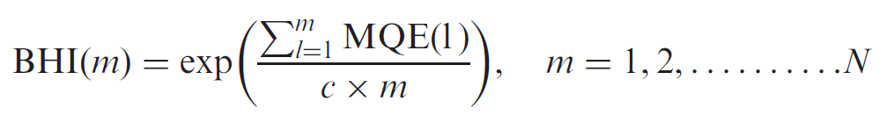
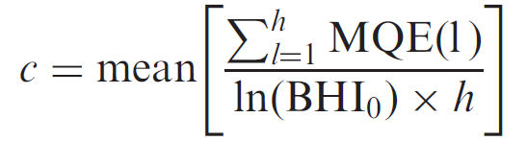
Methodology: Steps followed
5. BHI (Bearing Health Index)
For RUL estimation purposes, the input vector must be as much monotonic as possible and must increase gradually with the increase in bearing operating time.
BHI corresponds to an index that is monotonic with the bearing operation time. It gives an approach to extract the monotonicity from MQE.
A factor of c is introduced to adjust the scale of BHI and is helpful in maintaining similar BHI trends for different bearings working under the same conditions.
where h indicates the time-index sequence for healthy MQE values only and BHI0 denotes the starting value of BHI.

Slide 17
Methodology: Steps followed
6. Support Vector Regression (SVR)
The BHI values calculated in the previous step are supplied as inputs to the SVR and the outputs is taken as the life percentages calculated.
Then, the SVR model is trained using the input and output data and the hyperparameters are tuned to obtain the SVR model giving the best performance.

Slide 18
Methodology: Steps followed
7. Predicting RUL:
First, the feature extraction is performed on the test set data. After getting the feature vectors, the corresponding BMU are identified using the trained SOM model and the corresponding MQE values are calculated.
Once the MQE values are obtained, these are converted to the BHI. The BHI value for the last observation so obtained is then input to the trained SVR model which gives the normalized life percentage as the output.
Using the life percentage and the minutes features which corresponds to the time at which this the observations were taken, we get the minutes i.e. the time at which the bearing is about to fail as predicted by our model’s output which corresponds to the 100% of life percentage.
Minutes at 100% = 100 * (min at the last observation / predicted life percentage for last observation)
We get the RUL by subtracting the last observation’s minutes from the minutes at 100% which corresponds to the time left for the bearing to reach 100%

Slide 19
ImPLEMENTATION
A mathematical concept called Fourier Tranforms was used to get the frequency components from a time series of vibrations.
The input data contained raw signals, and as there was a need to get the envelope signals so as to calculate the entropy of envelope signal, it was obtained by using the Hilbert function.
A different feature was created to calculate the Life Percentage which was required as the target to train the SVR. The feature ‘minutes’ which corresponds to the minutes for which the bearing is running and the instance when the observations were taken which were used for feature extraction was created for each feature vector.

Slide 20
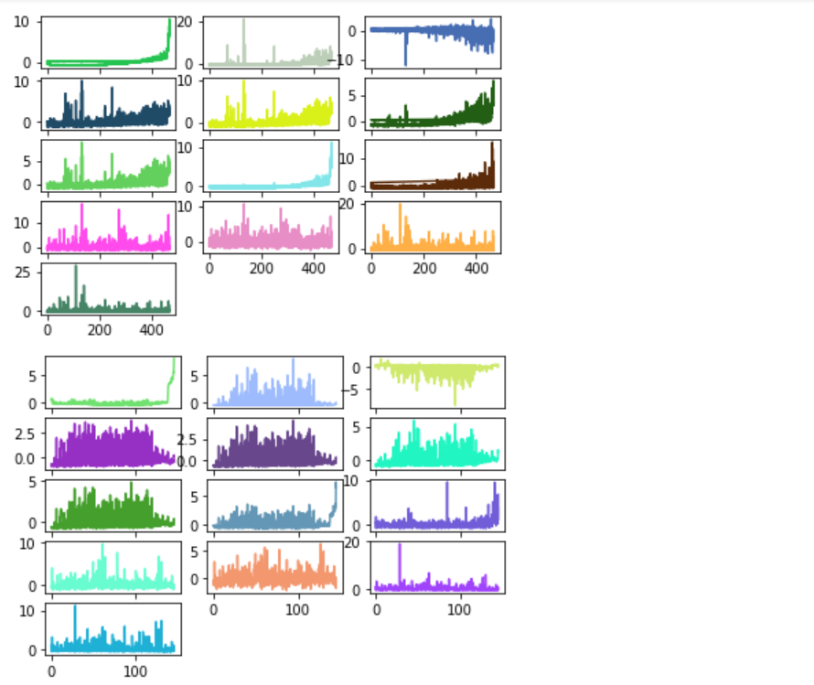
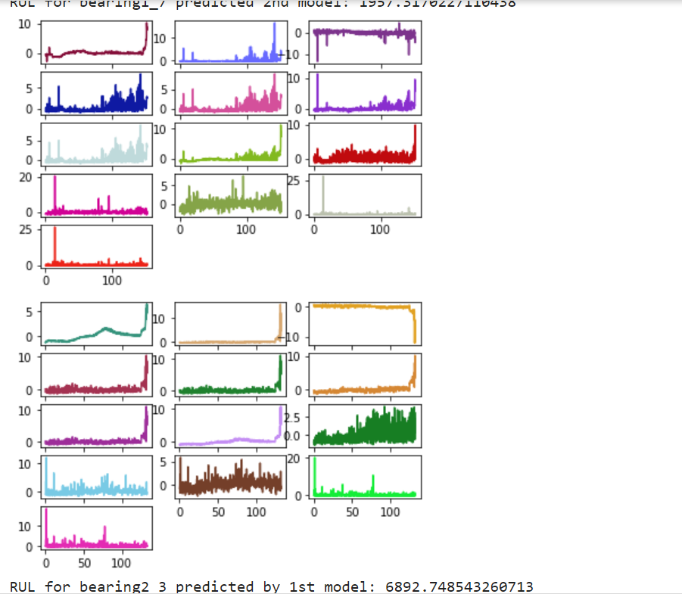
Features Extracted
E.g. Bearing Under Condition 1
E.g. Bearing Under Condition 2

Slide 21
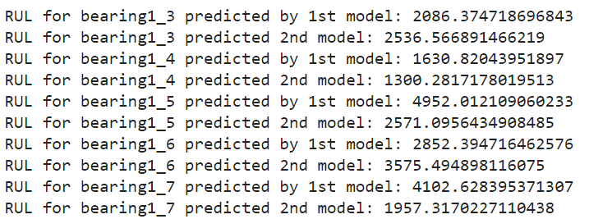
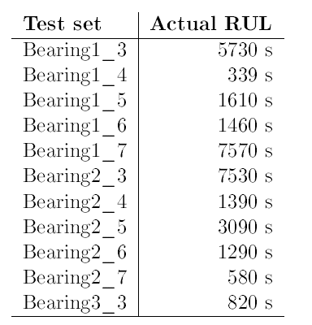
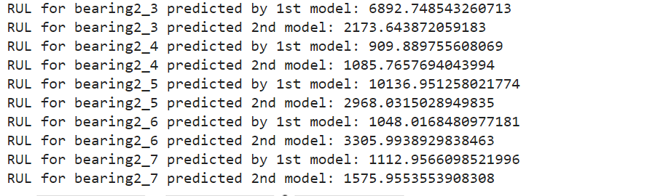
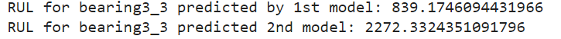
RESULTS

Slide 22
ACKNOWLEDGEMENT
We take this opportunity to thank the department of Computer Engineering and IT, VJTI for giving us an opportunity to work on this project. We would also like to thank our mentor Prof. S. S. Udmale Sir for his invaluable guidance and support throughout the project work. We would also like to congratulate our team members for their utmost efforts in making this project a success and implementing it to a deliverable level.

Slide 23
References
https://journals.sagepub.com/doi/10.1177/0954406217700180
https://github.com/wkzs111/phm-ieee-2012-data-challenge-dataset
https://github.com/sevamoo/SOMPY
https://docs.scipy.org/doc/scipy/reference/generated/scipy.fft.fft.html
https://docs.scipy.org/doc/scipy/reference/generated/scipy.signal.hilbert.html

